Slide 1
Team Design Projects and Skills Presentation
Team 44: FastFurious
Jun. 8th , 2023

Slide 2
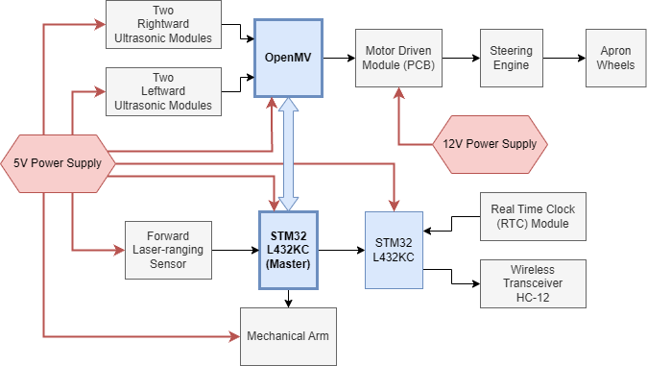
System Design

Slide 3
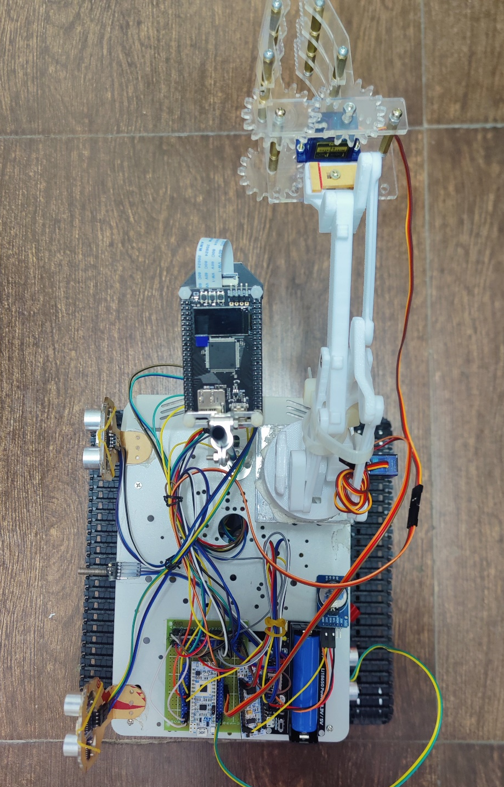
System Design
Mechanical Arm
Top View
Real Time Clock (RTC) Module
Two STM32L432KC
5V Power Supply

Slide 4
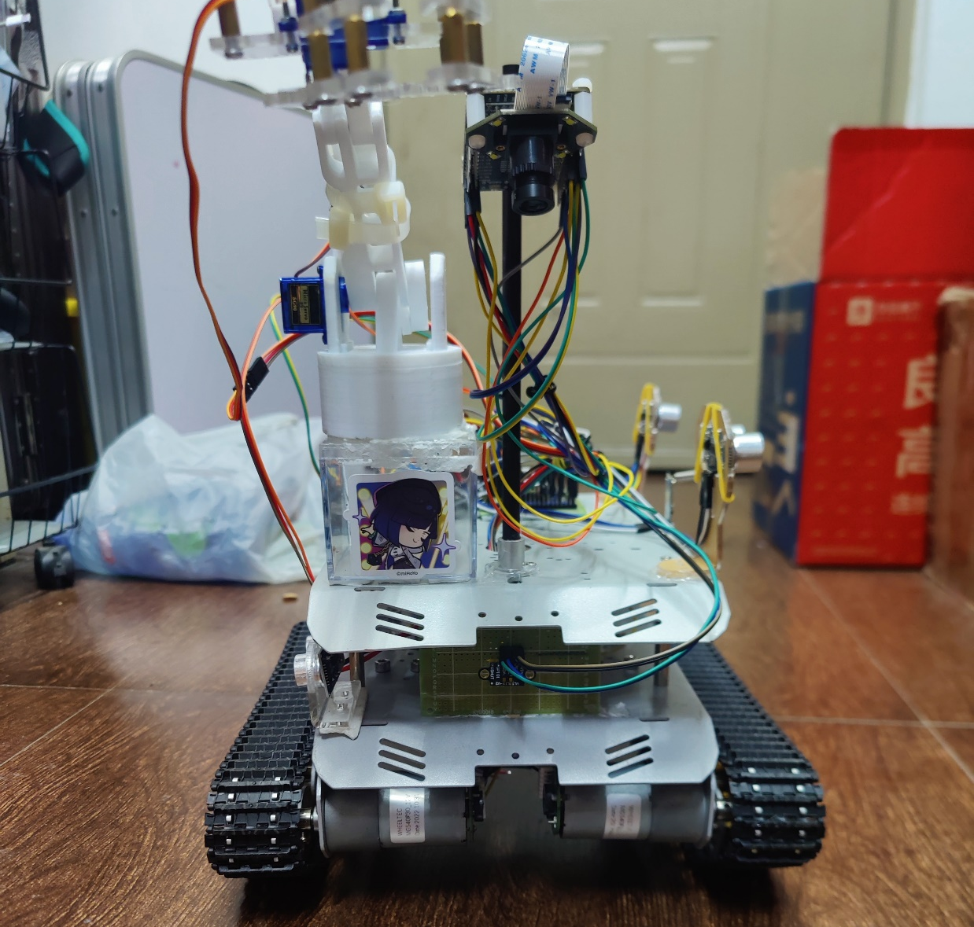
System Design
OpenMV
Front View
Forward Laser-ranging Sensor
Steering Engine

Slide 5
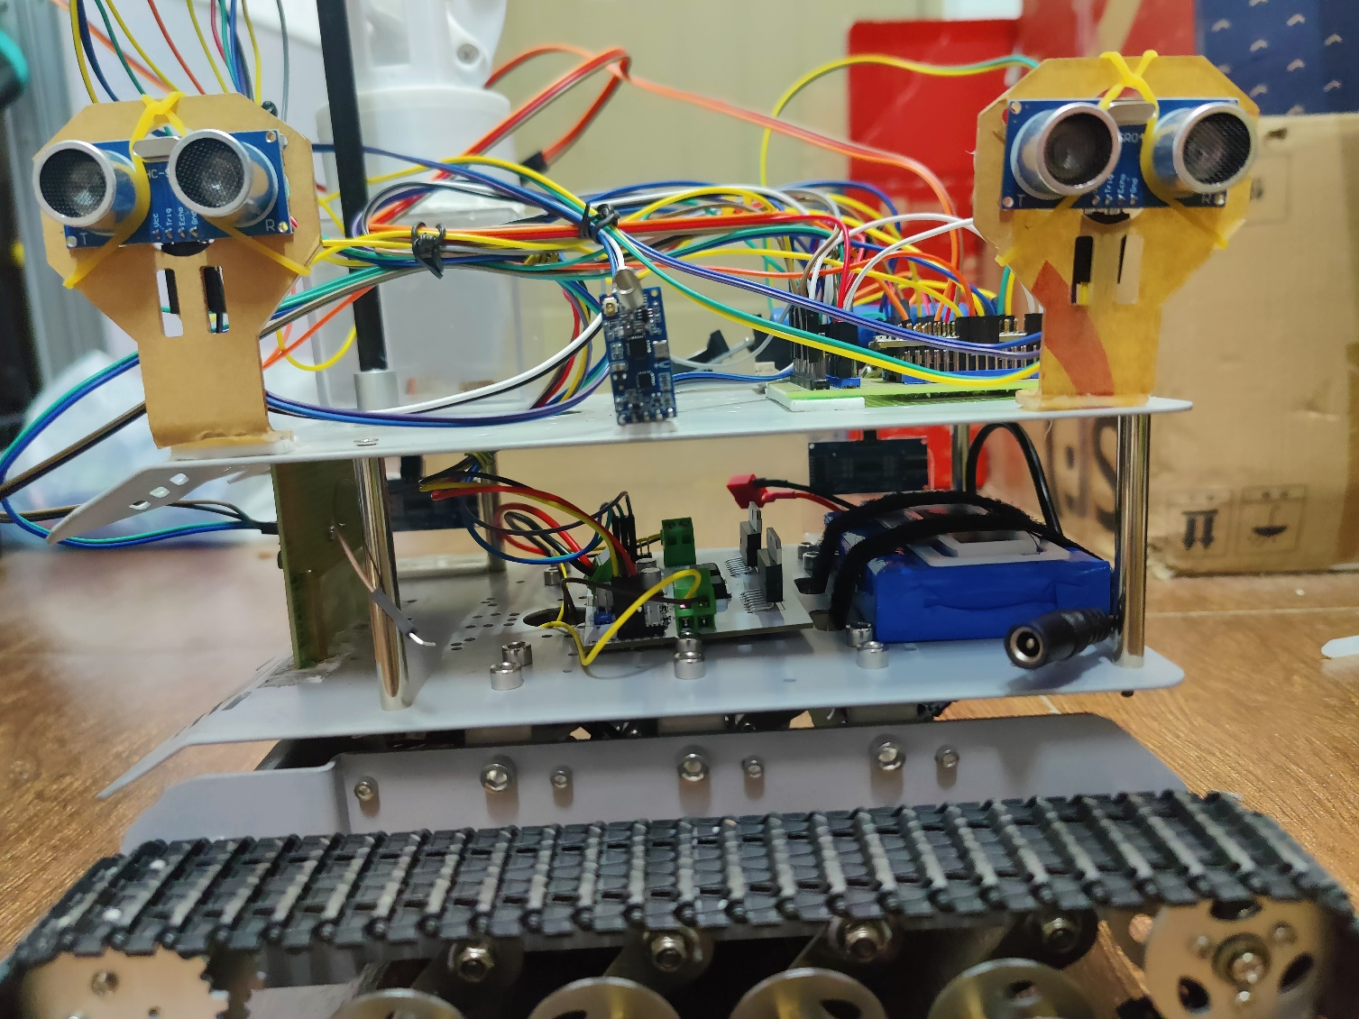
System Design
Leftward Ultrasonic Module
Leftward Ultrasonic Module
Left View
Wireless Transceiver HC-12
12V Power Supply

Slide 6
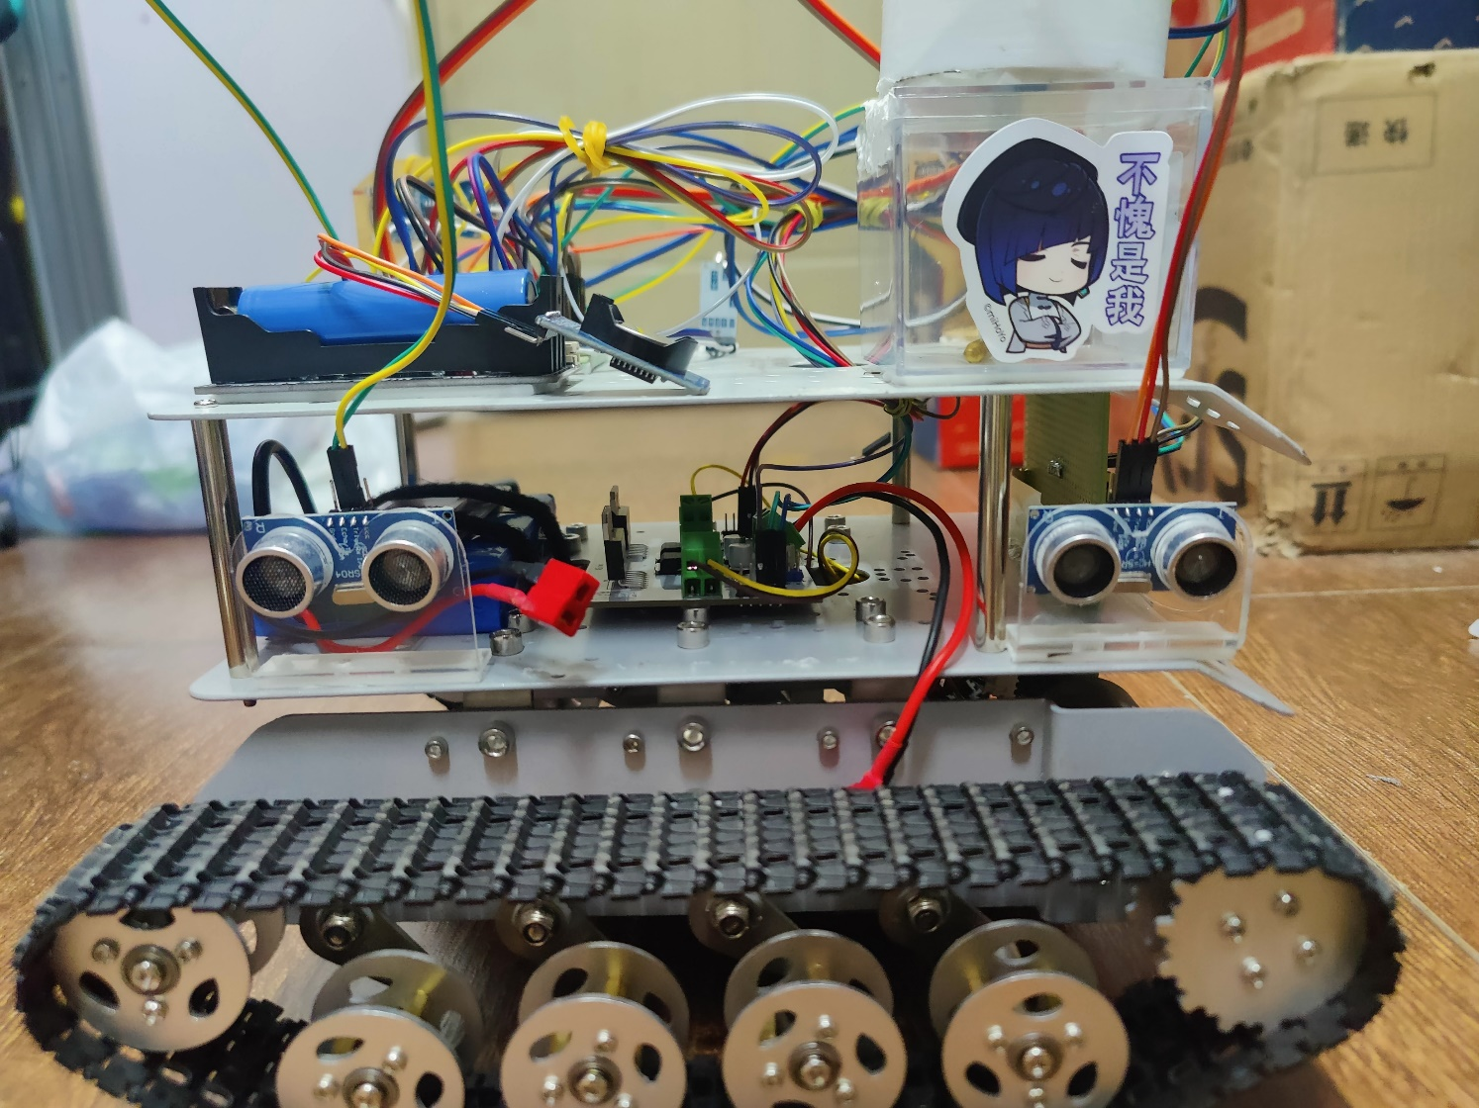
System Design
Rightward Ultrasonic Module
Right View
Rightward Ultrasonic Module
Motor Driven Module (PCB)

Slide 7
Patio 1
Task 1

Slide 8
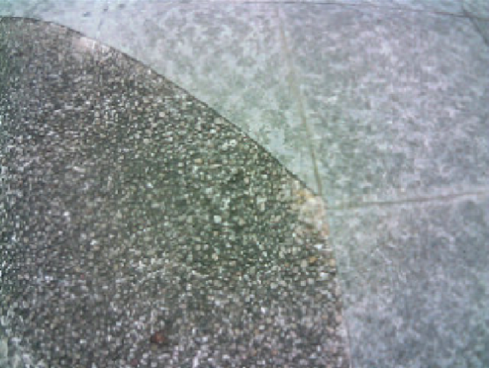
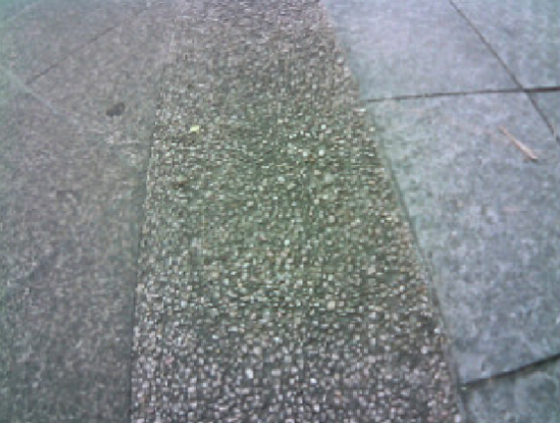
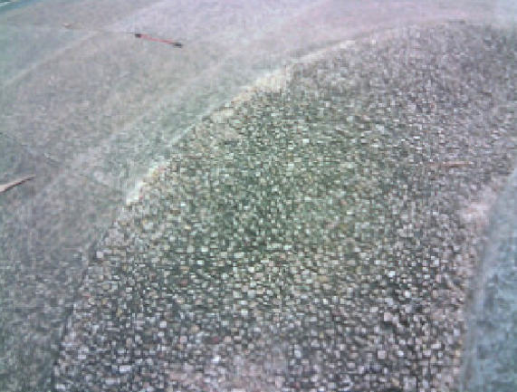
Patio1 Task1 – Line Tracking
Line Following Algorithm
320
RGB 565 Pixel format
240
Picture frame size 320*240 (pixels)
The road has abundant edge features
Use the edge detection algorithm to process image

Slide 9
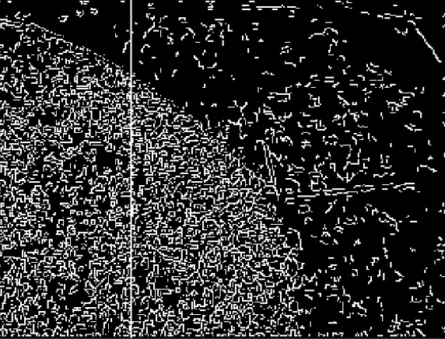
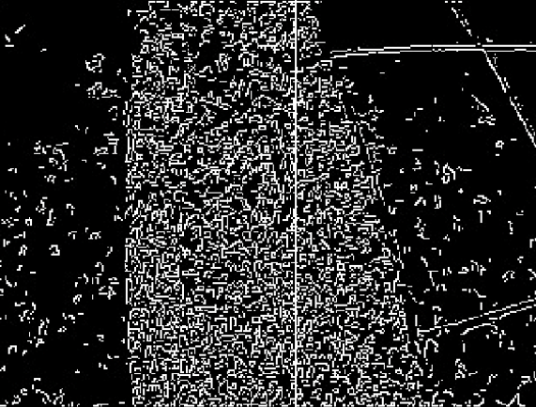
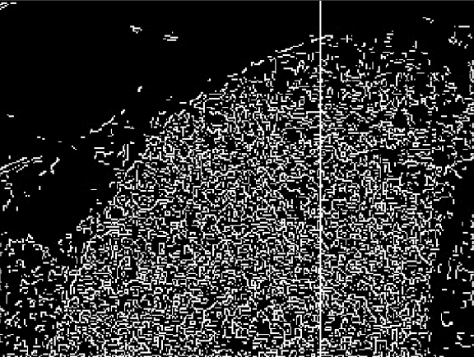
Patio1 Task1 – Line Tracking
Line Following Algorithm
320
RGB 565
Divide image into 40 regions
(8*240 pixels for each region)
240
Calculate the mean value of grayscale value in each region
8
……
8 8 8
……
Grayscale image （After edge detection processed）
Find the line we need (the mass center of white pixels)

Slide 10
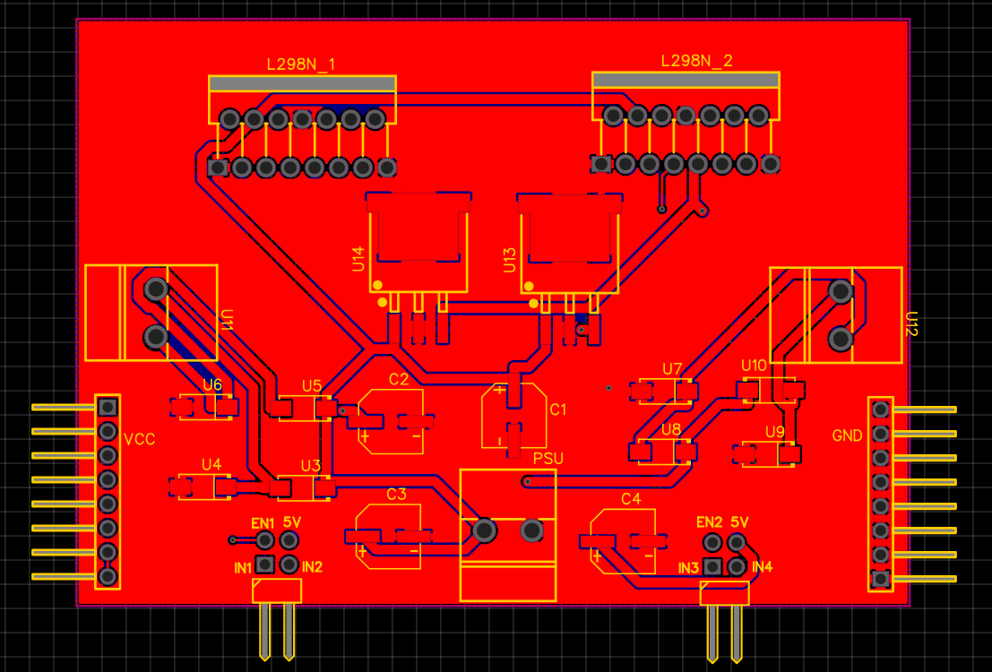
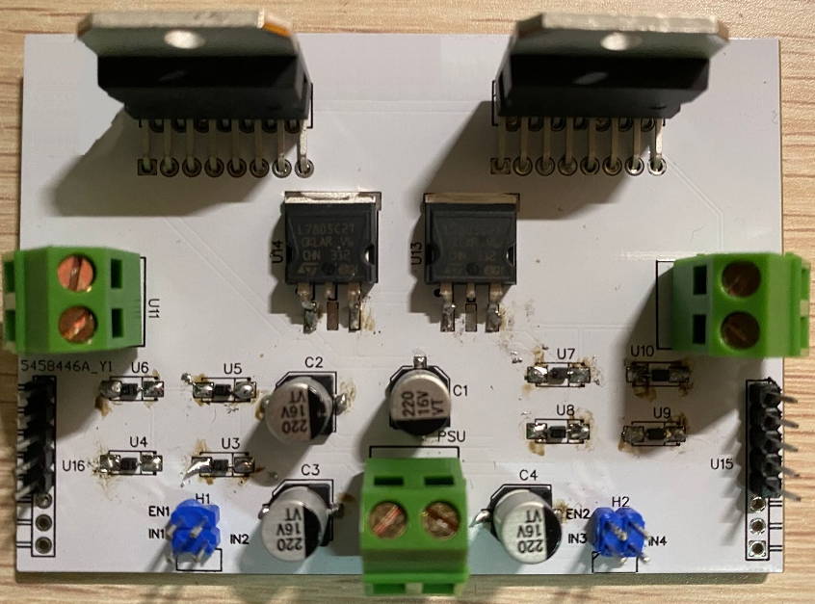
Patio1 Task1 – Motor Driven Module
Dual L298n Structure
- One L298n power one motor
- 12V Input
Multiple Ground (GND) terminals
Created through JLC
Input 1 | Input 2 | Enable A | OUTPUT1
0 | 0 | x | Brake
1 | 0 | PWM | Positive Speed Control
0 | 1 | PWM | Negative Speed Control

Slide 11
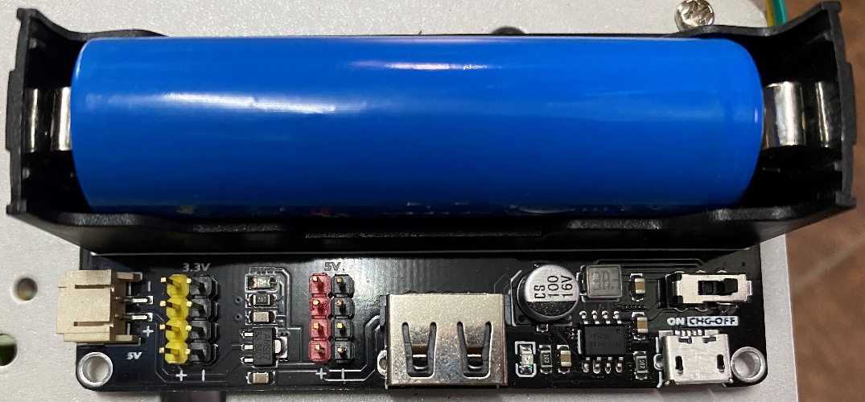
Patio1 Task1 – 5V Power Supply Module
Power Mbed, OpenMv, laser-ranging module, ultrasonic module, mechanical arm
Use 18650 Lithium Battery
3.3V & 5V Output

Slide 12
Patio 1
Task 2

Slide 13
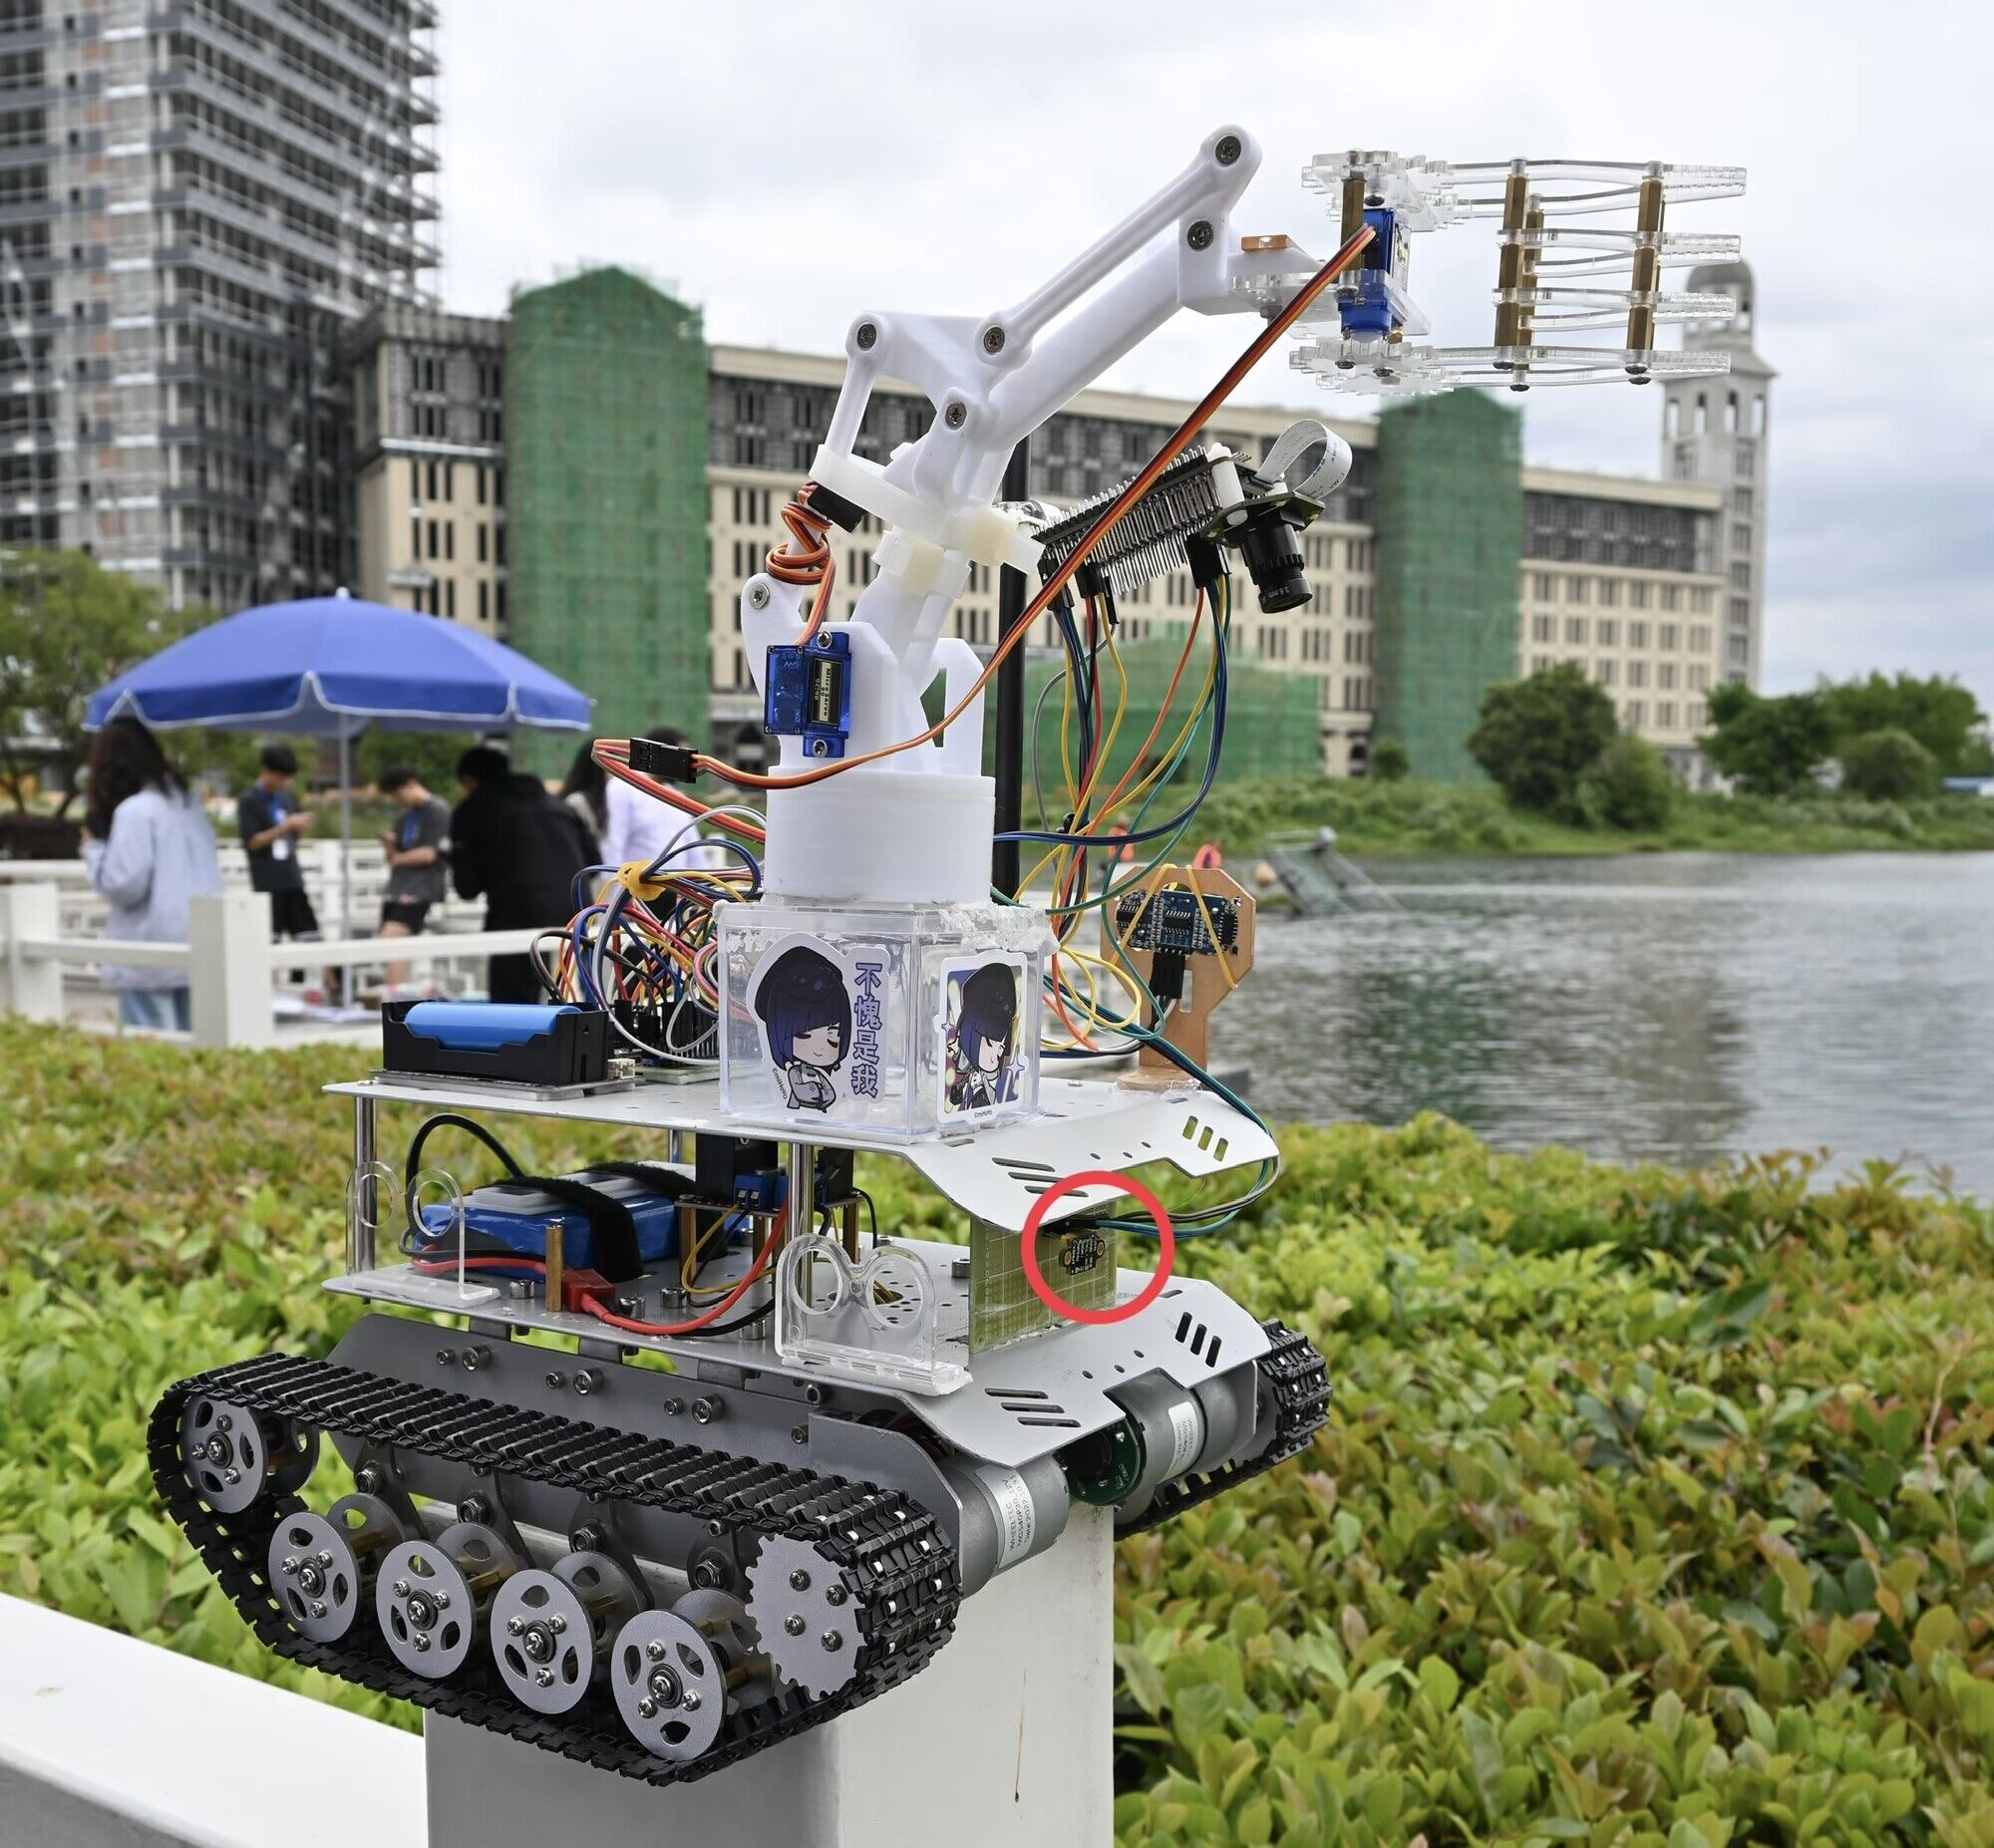
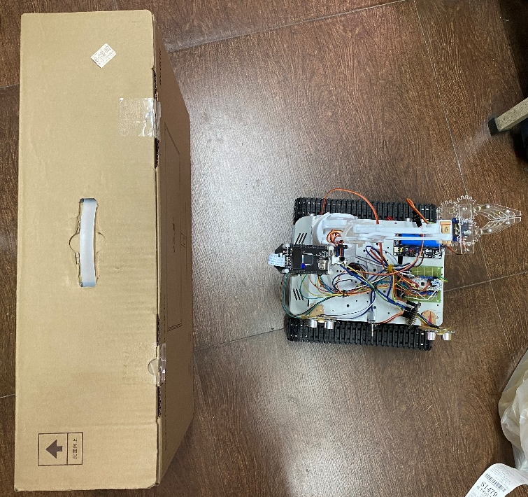
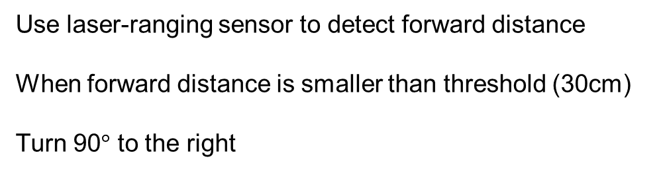
Patio1 Task2 – Beacon Detection
Use laser-ranging sensor to detect forward distance
When forward distance is smaller than threshold (30cm)
Turn 90$°$ to the right
Direction of Bridge
Beacon 1
Forward Distance
Notes:
yzj

Slide 14
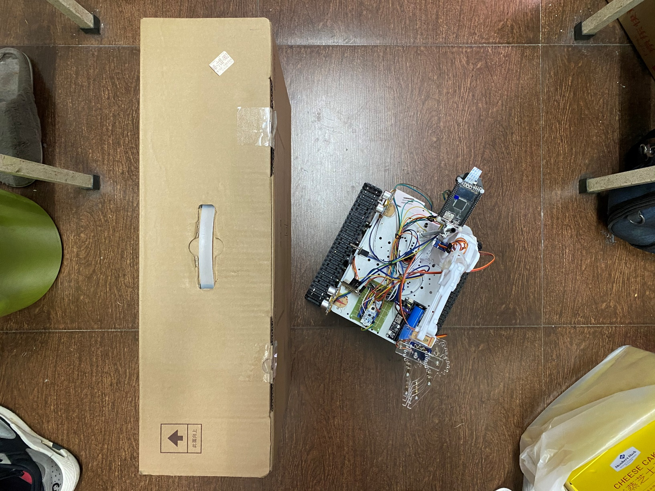
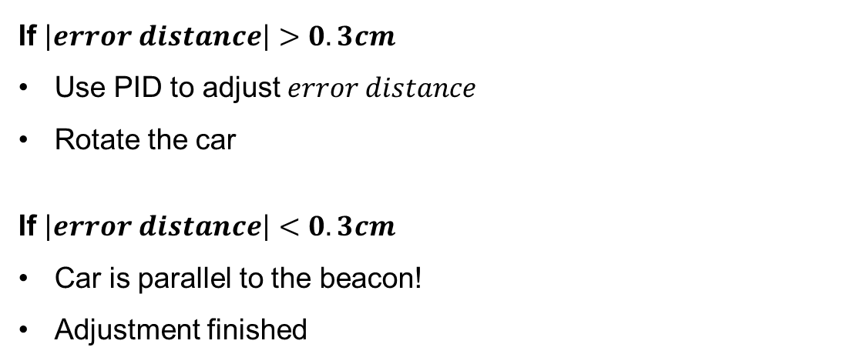
Patio1 Task2 – Horizontal Adjustment System
Problems Met
Cannot ensure 90°rotation
Cannot pass the bridge straightly
Direction of Bridge
Beacon 1
distance 1
Ultrasonic 1
$$error distance=distance 1−distance 2$$
If $\left|error distance\right|>0.3cm$
Use PID to adjust $error distance$
Rotate the car
If $\left|error distance\right|<0.3cm$
Car is parallel to the beacon!
Adjustment finished
Ultrasonic 2
distance 2
Notes:
yzj

Slide 15
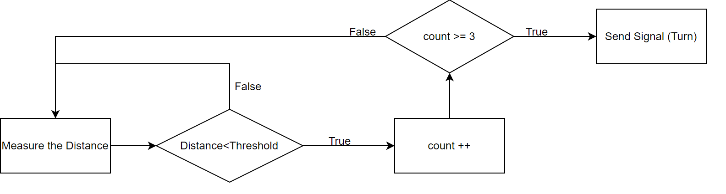
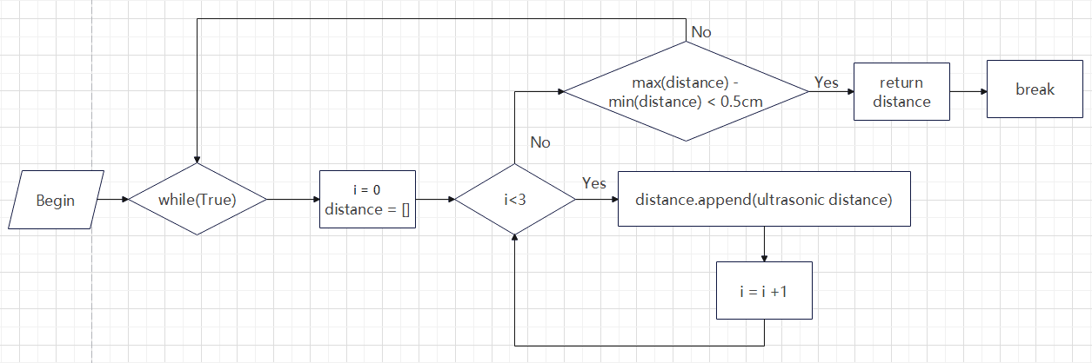
Patio1 Task2 – Filtering System Design
Filtering of Laser-ranging Sensor
If three consecutive measured distance less than threshold, STM32 send a signal telling OpenMV to turn
Filtering of Ultrasonic Module
Measure the distance for three consecutive times. If the difference between the maximum value and the minimum value is less than 0.5cm, return the average value of three measurements
Notes:
zzx

Slide 16
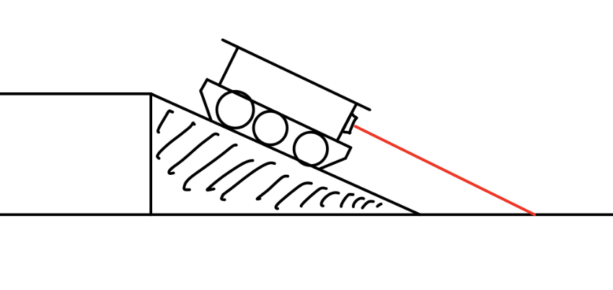
Patio1 Task2 – Cross the Bridge
Go on the Bridge
Quadrature Decoder is not used – Unable to acquire actual speed
Original speed cannot go on the bridge
Increase the speed
Go off the Bridge
Forward distance might small than threshold
Turn off the sensor after previous right turn
Delay the activation of sensor
Forward Laser-ranging Sensor
Bridge
Forward Distance
Notes:
zzx

Slide 17
Patio 1
Task 3

Slide 18
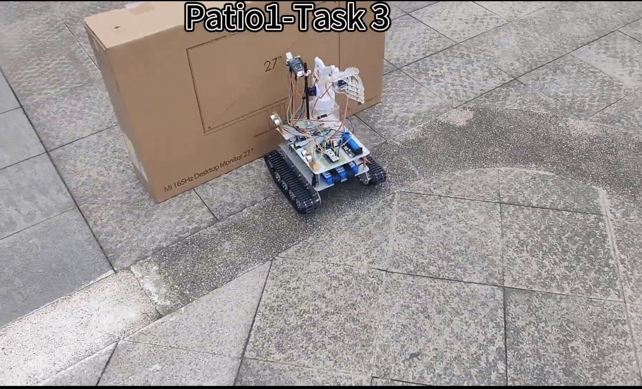
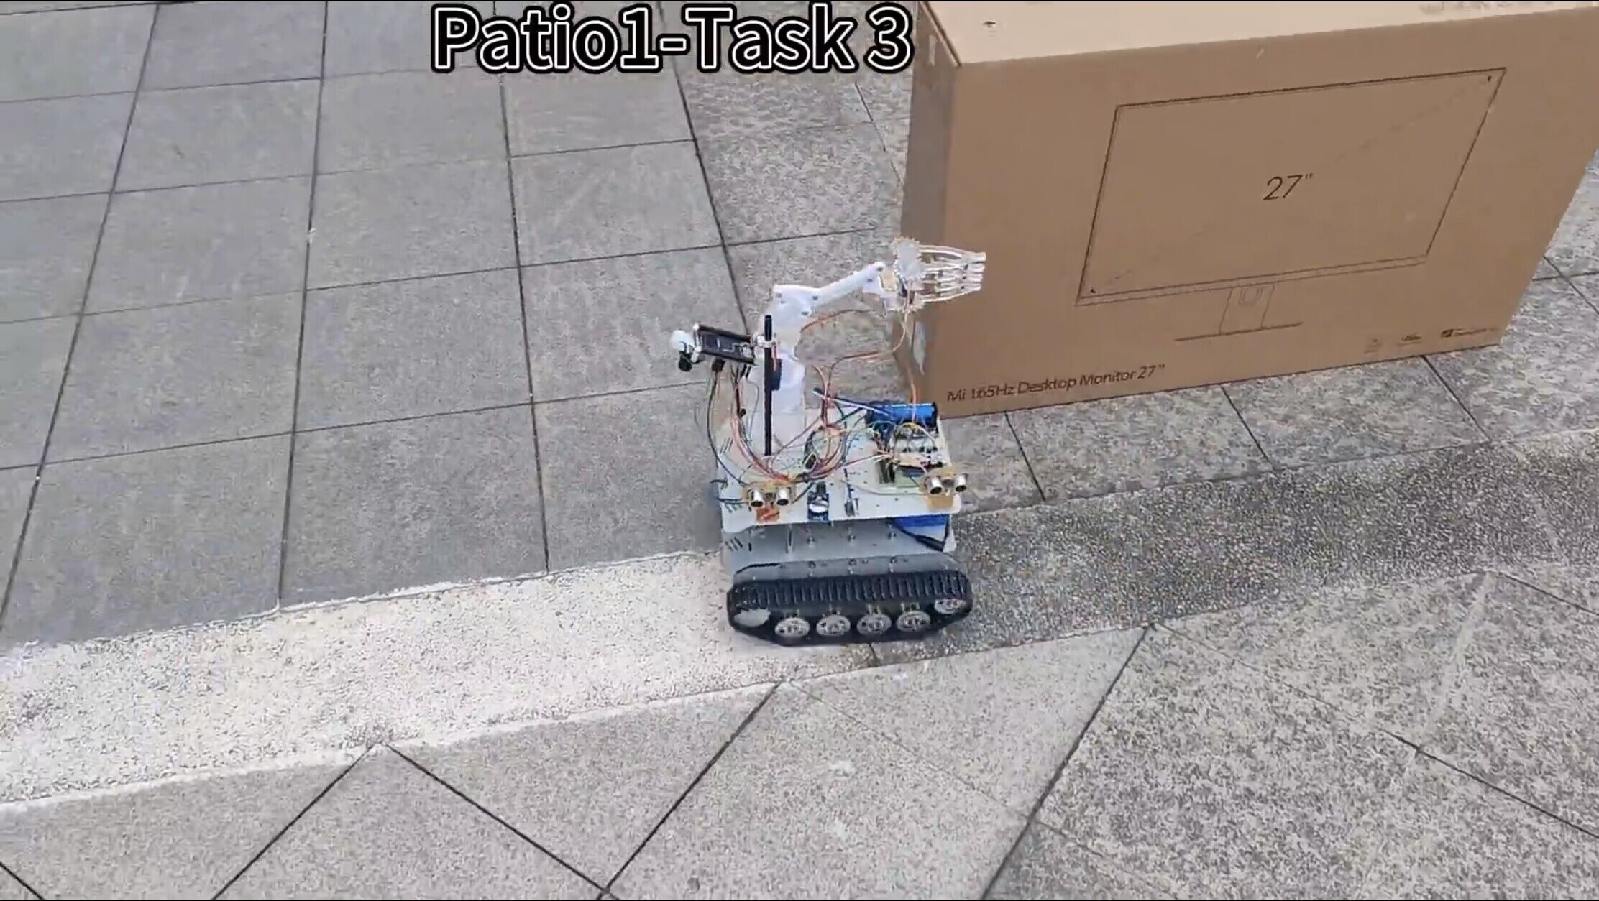
Patio1 Task3 – Through the Gate
Detect the beacon by using laser-ranging sensor
When forward distance is smaller than threshold (30cm)
Turn 90°to the left
Turn on the timer
Notes:
gyn

Slide 19
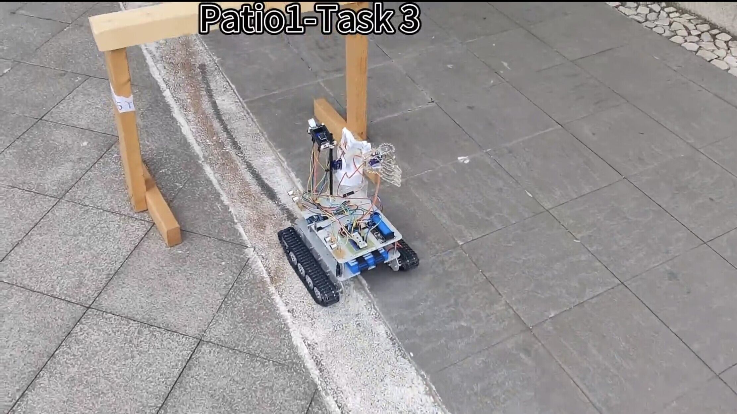
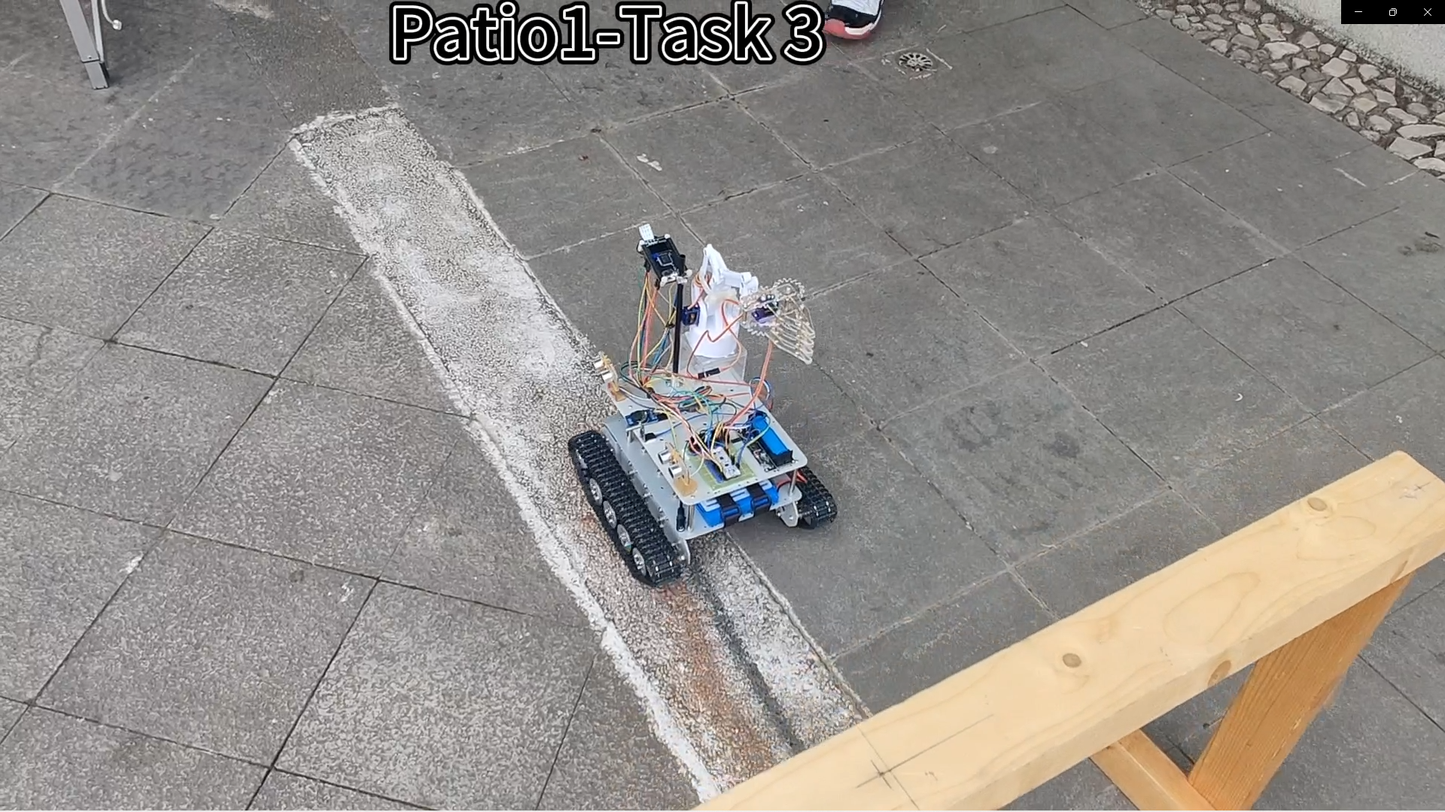
Patio1 Task3 – Through the Gate
Start line-tracking by OpenMV
When the value of the timer is larger than preset value, power off the car
Notes:
gyn

Slide 20
Patio 2
Task 1

Slide 21
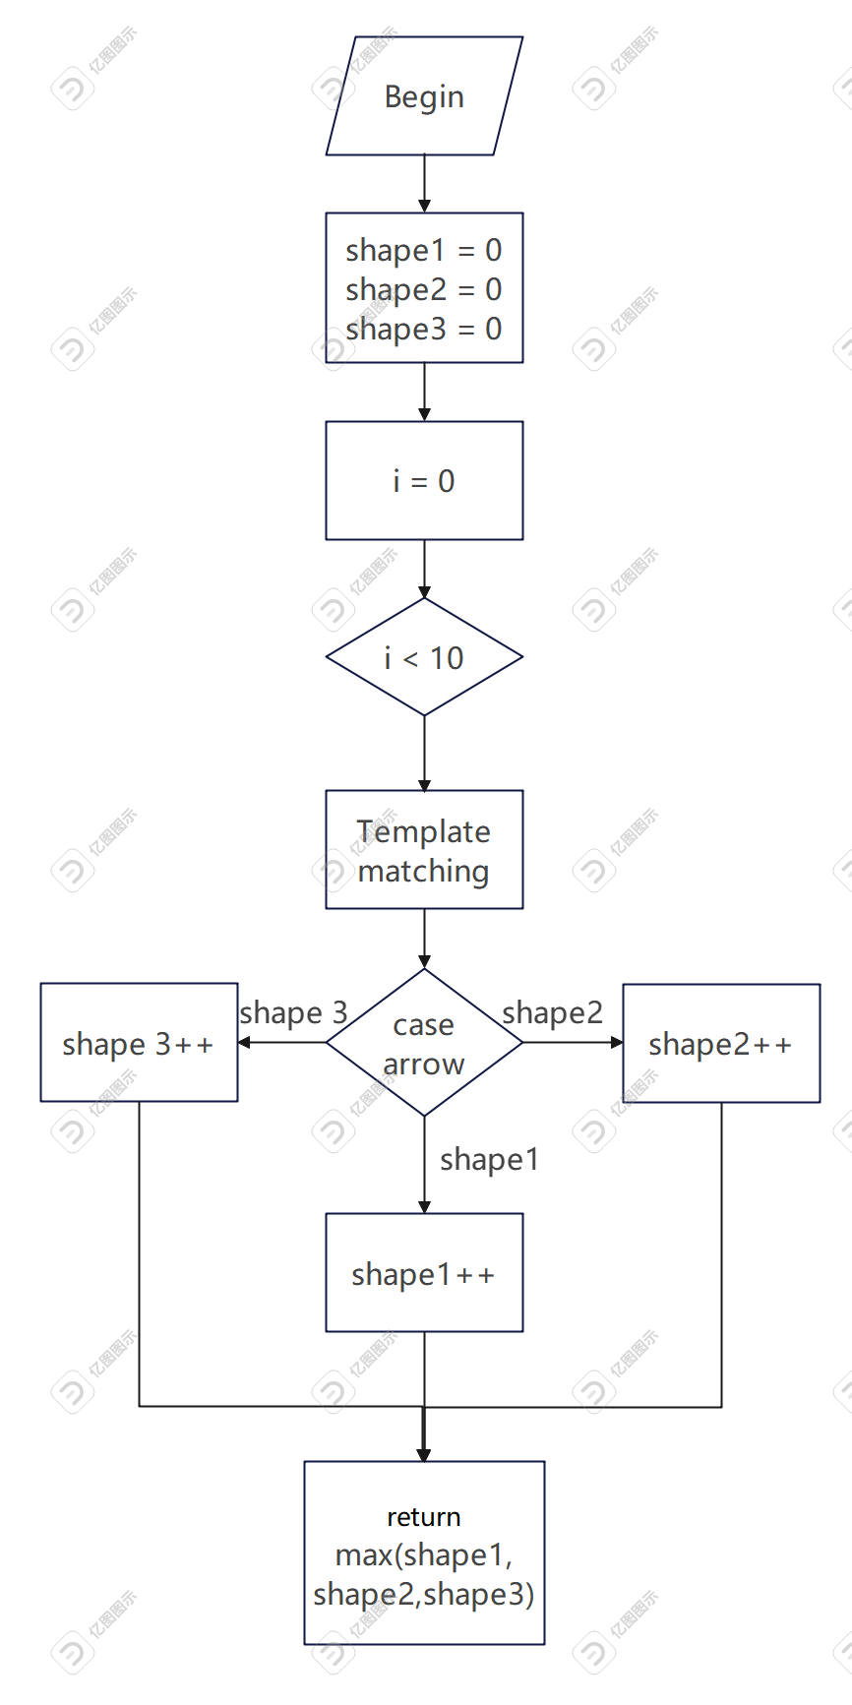
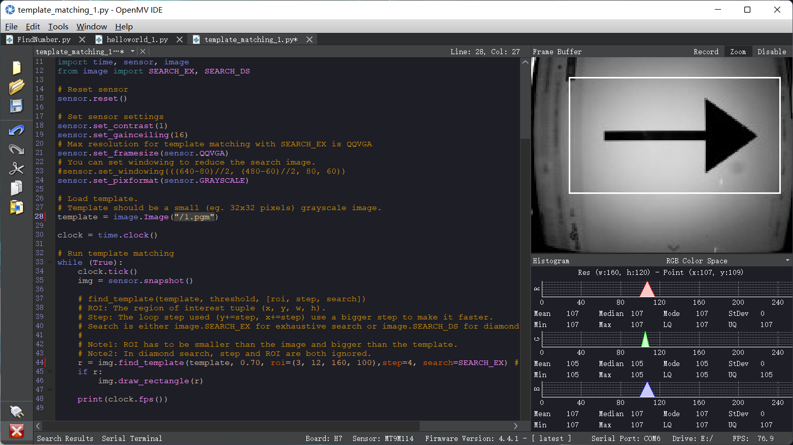
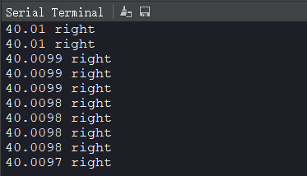
Patio2 Task1 – Arrow Shape Recognition
Method: Template matching
Algorithm: Normalized Cross Correlation (NCC)

Slide 22
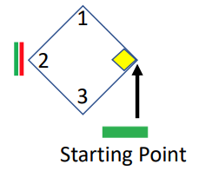
Patio2 Task1 – Go to the Arrow
Preset speed and direction
Line Tracking
Line Tracking
Laser detection and stop

Slide 23
Patio 2
Task 2

Slide 24
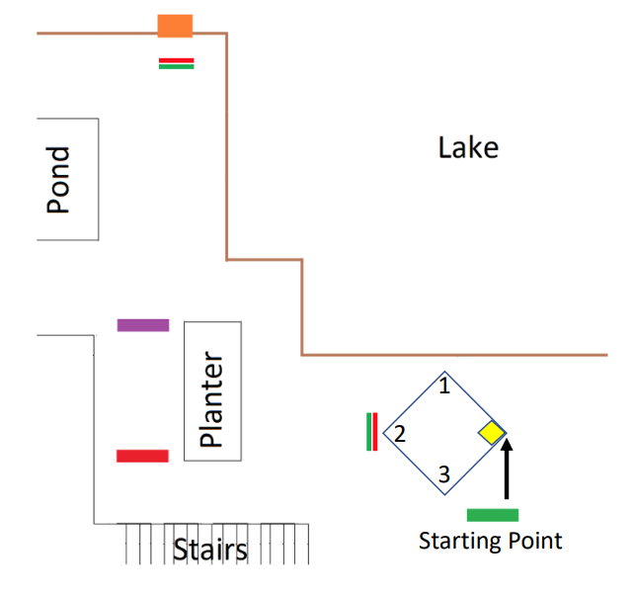
Patio2 Task2 – Reach the Basket
Designed route

Slide 25
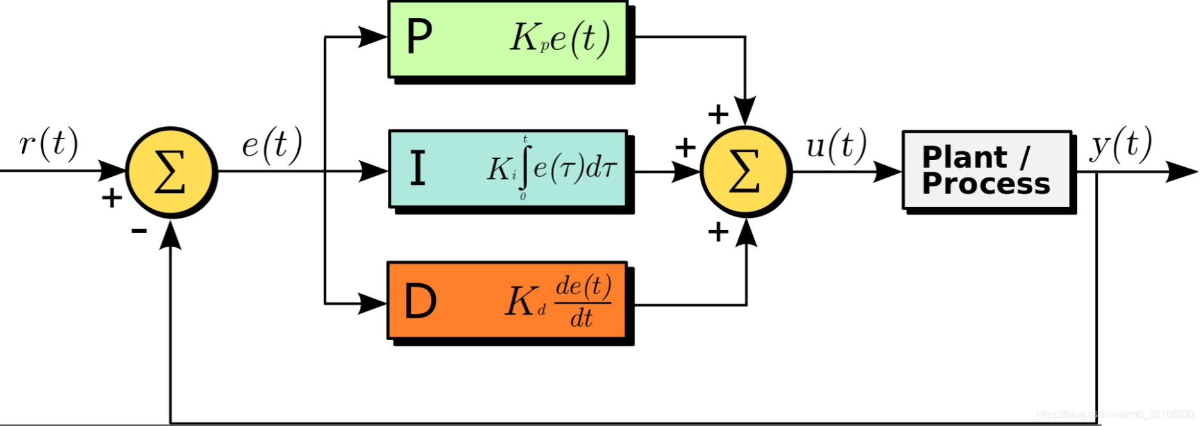
Patio2 Task2 – PID Control System

Slide 26
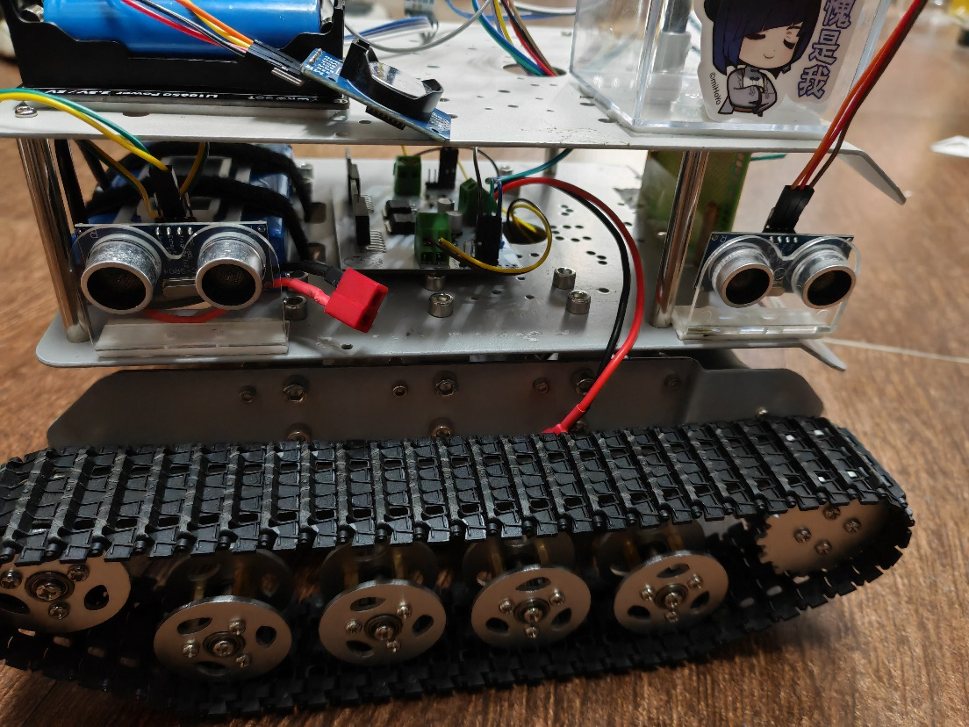
Patio2 Task2 – Ultrasonic Edge Detection
Control variables
• Steering angle
• Deviation distance
Ultrasonic sensor
Car
preset distance
Theta error
Distance error
Car
Car
ᶿ

Slide 27

Patio2 Task2 – Ultrasonic Edge Detection
Preset Distance
Distance 2
Distance 2
Car
$$∆D$$
ᶿ
Car
Distance 1
Distance 1
$$Theta error=distance 1−distance 2$$
$$Distance error=\frac{distance 1+distance 2}{2}−preset distance$$

Slide 28
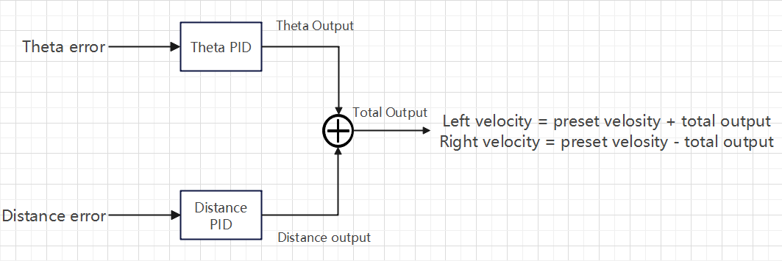
Patio2 Task2 – Ultrasonic Edge Detection

Slide 29
Patio2 Task2 – Steering Logic
No signal
Laser detection
Car
Car
Turn after a one-second delay

Slide 30
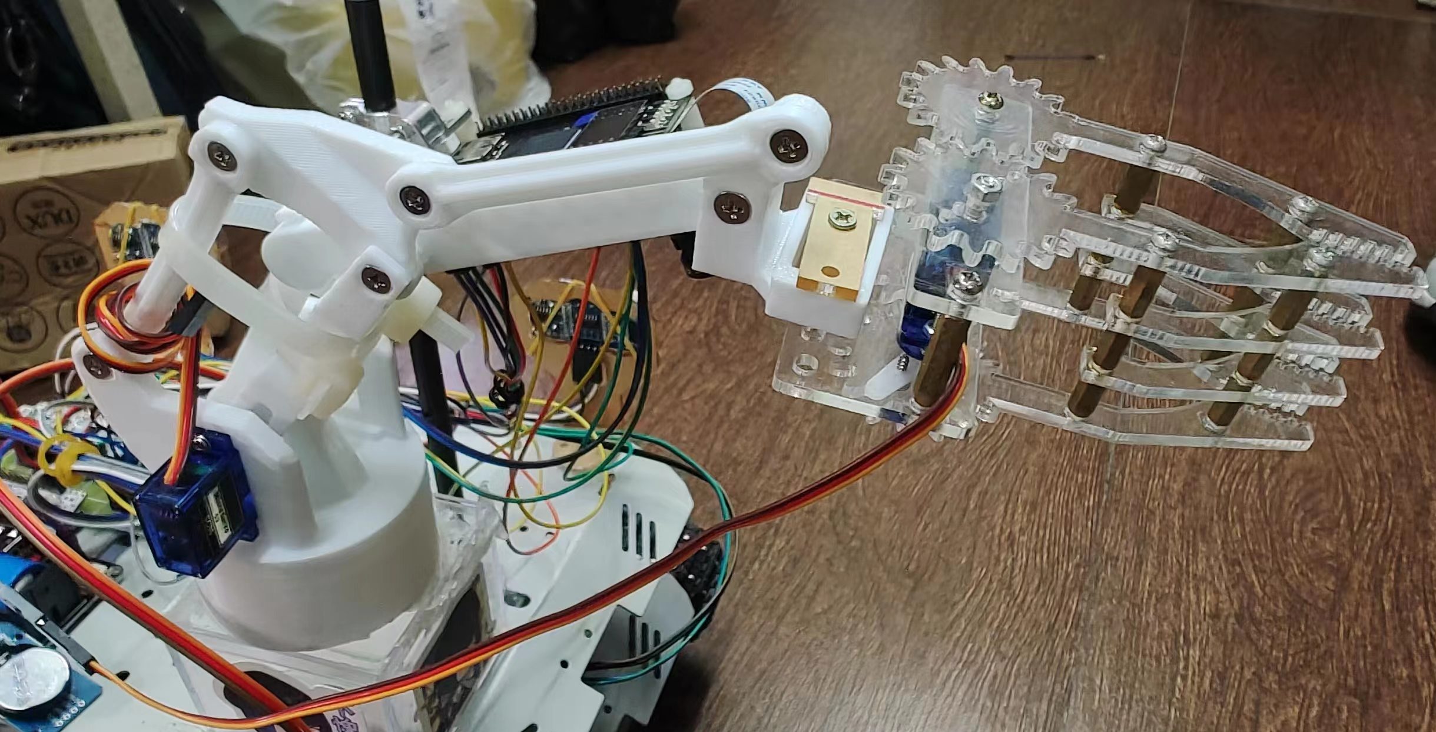
Patio2 Task2 – Mechanical Arm

Slide 31
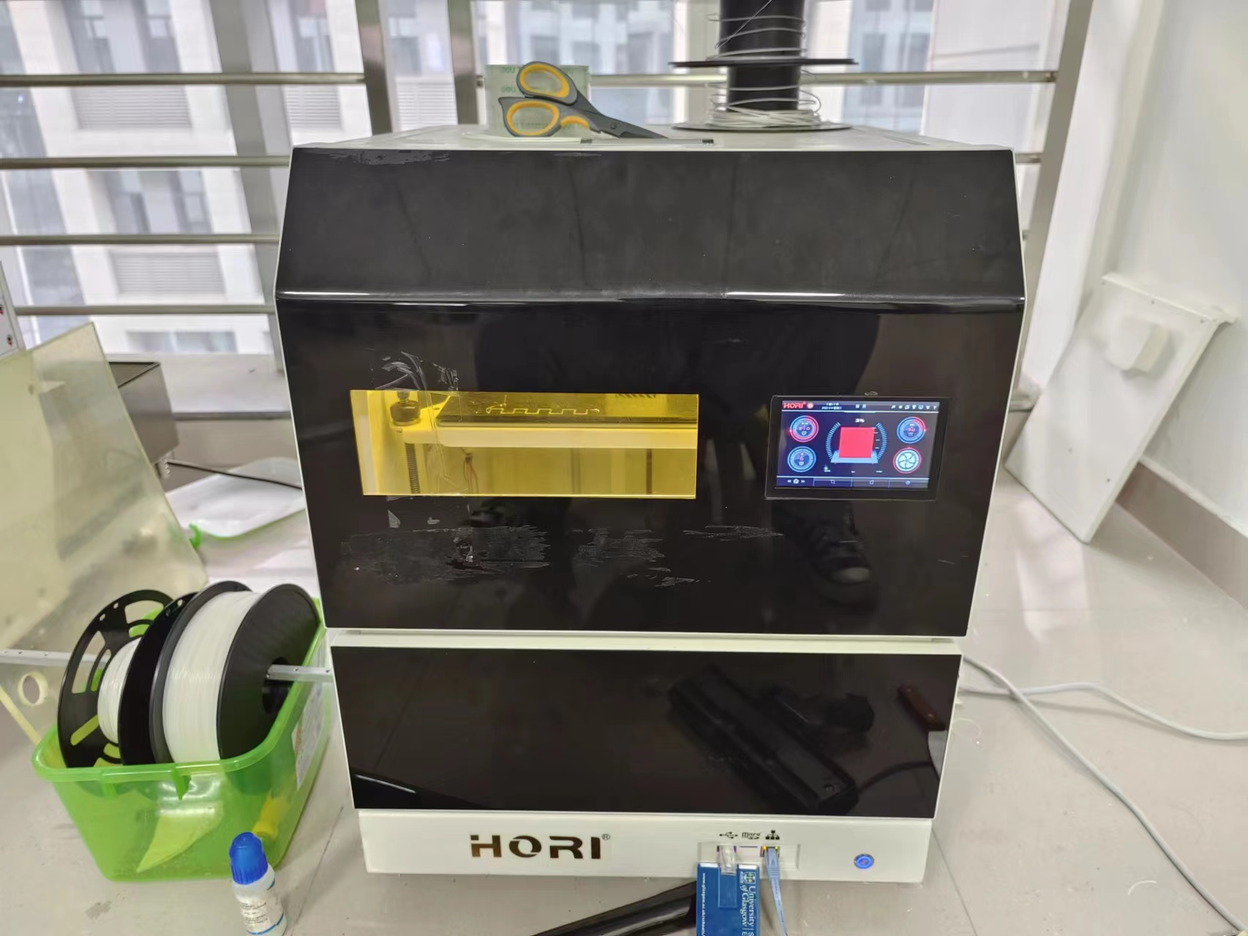
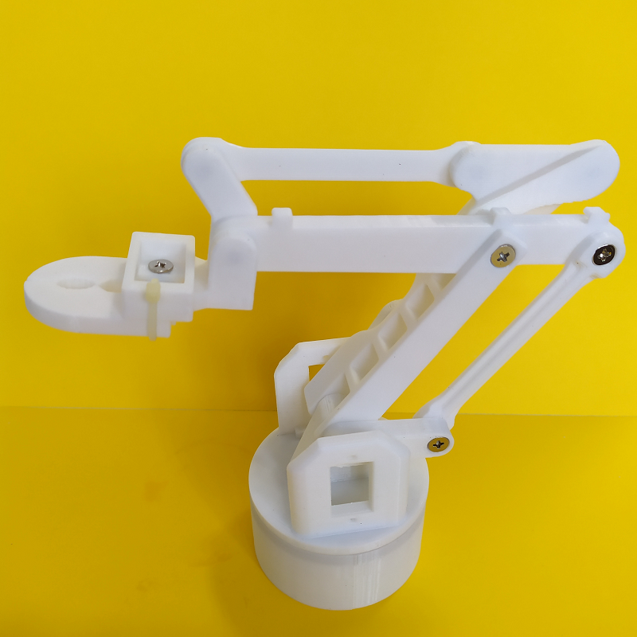
Patio2 Task2 – Mechanical Arm
4 axes and 4 degrees of freedom
Mechanical arm bracket and connectors: 3D-Printing
Printer model: (HORI)Z300
Material: PLA（polylactic acid）
Structure
Clip height: 12cm
Chassis diameter: 62mm
Shoulder height: 16cm

Slide 32
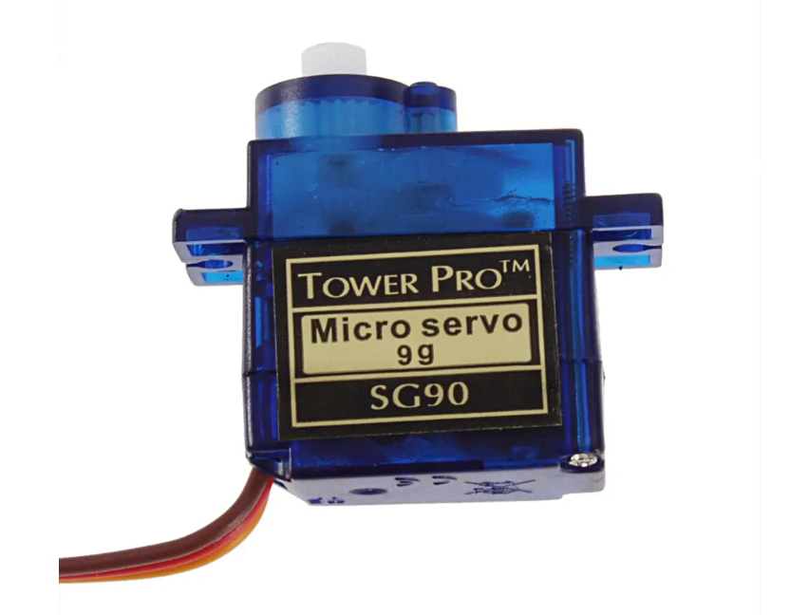
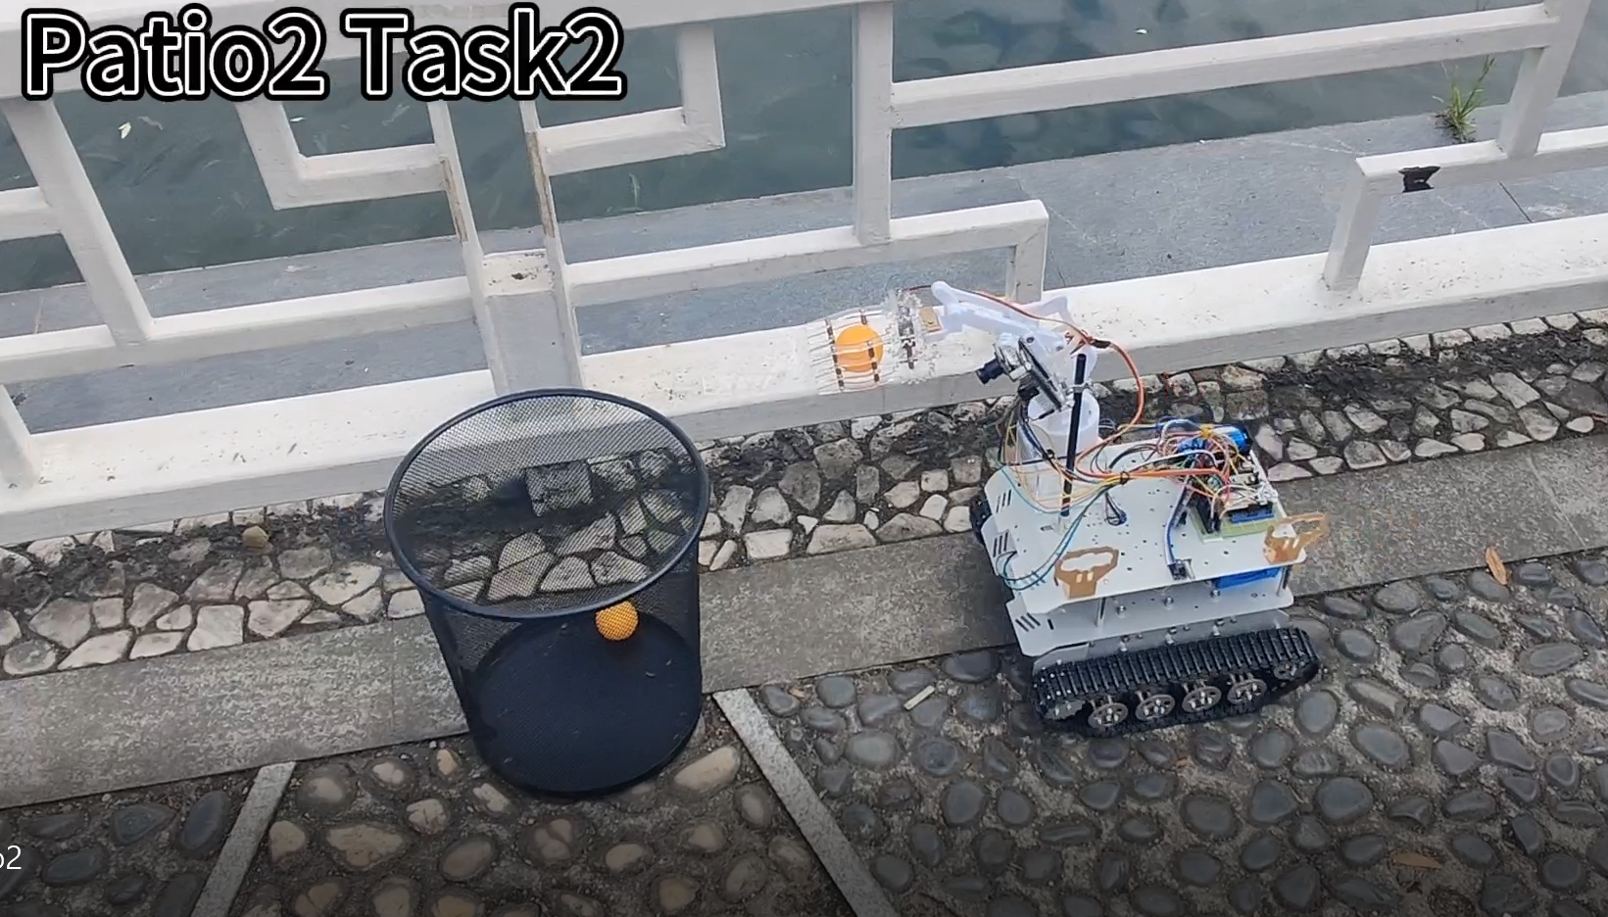
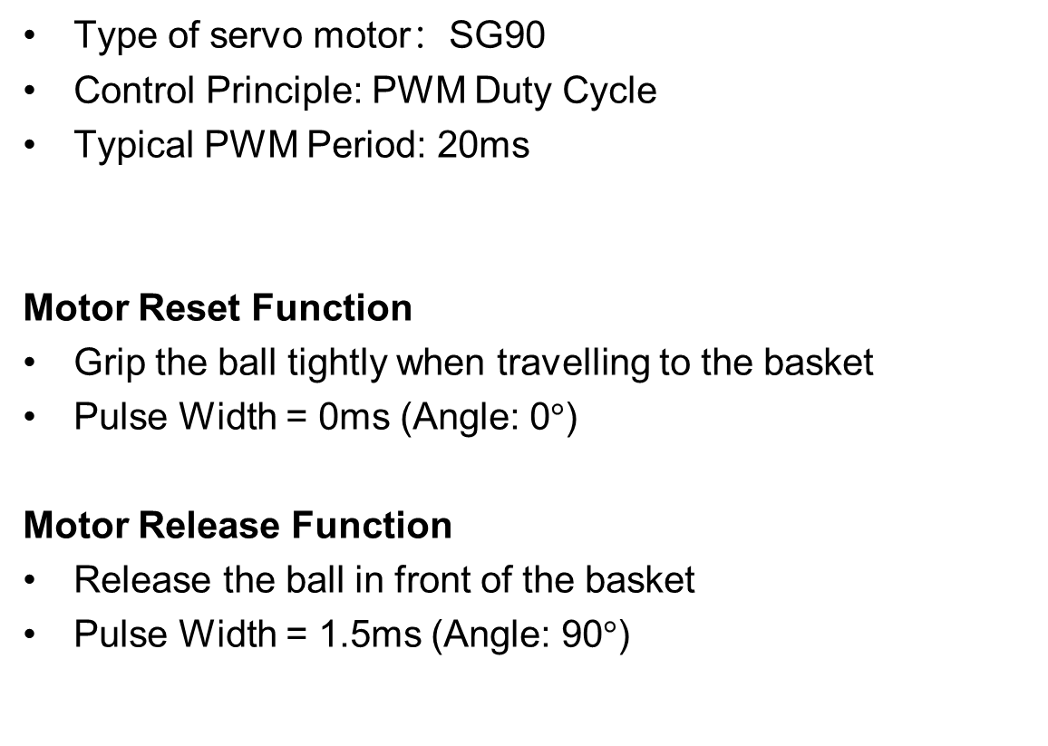
Patio2 Task2 – Mechanical Arm
Type of servo motor：SG90
Control Principle: PWM Duty Cycle
Typical PWM Period: 20ms
Motor Reset Function
Grip the ball tightly when travelling to the basket
Pulse Width = 0ms (Angle: 0$°$)
Motor Release Function
Release the ball in front of the basket
Pulse Width = 1.5ms (Angle: 90$°$)
Forward Distance

Slide 33
Patio 2
Task 3

Slide 34
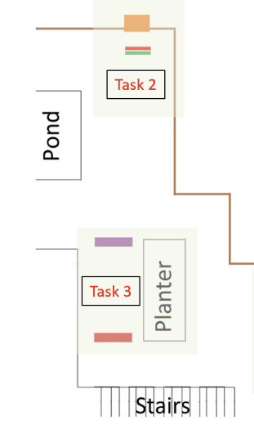
Patio2 Task3 – Enter Planter Area
Part1. From the basket to the destination
Preset behavior
Turn left for 90°
Go straight for 50s
Stop in Planter
Pull-up comm-out pin

Slide 35
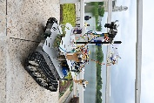
Part1. Situation 1
Patio2 Task3 – Enter Planter Area
When car goes straight
(No ultrasonic signal received)

Slide 36
Part1. Situation 2
Patio2 Task3 – Enter Planter Area
When car goes on left direction
(Ultrasonic module in left side detects signal)

Slide 37
Part1. Situation 3
Patio2 Task3 – Enter Planter Area
When car goes on right direction
(Ultrasonic module in right side detects signal)

Slide 38
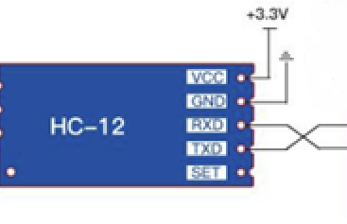
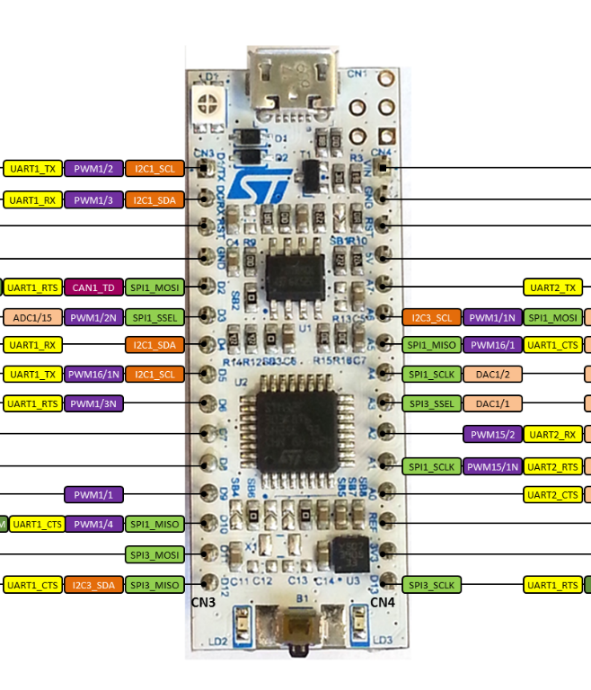
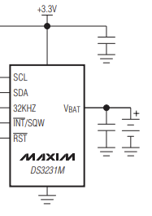
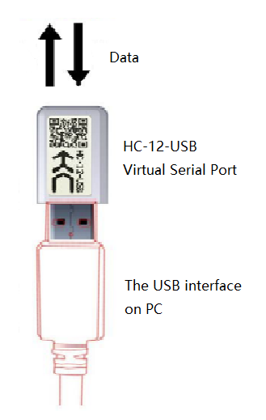
Part2. Send real-time time and team information
Patio2 Task3 – Wireless Communication
Bluetooth: HC12
MCU: L432
Clock: DS3231
DigitalIn

Slide 39
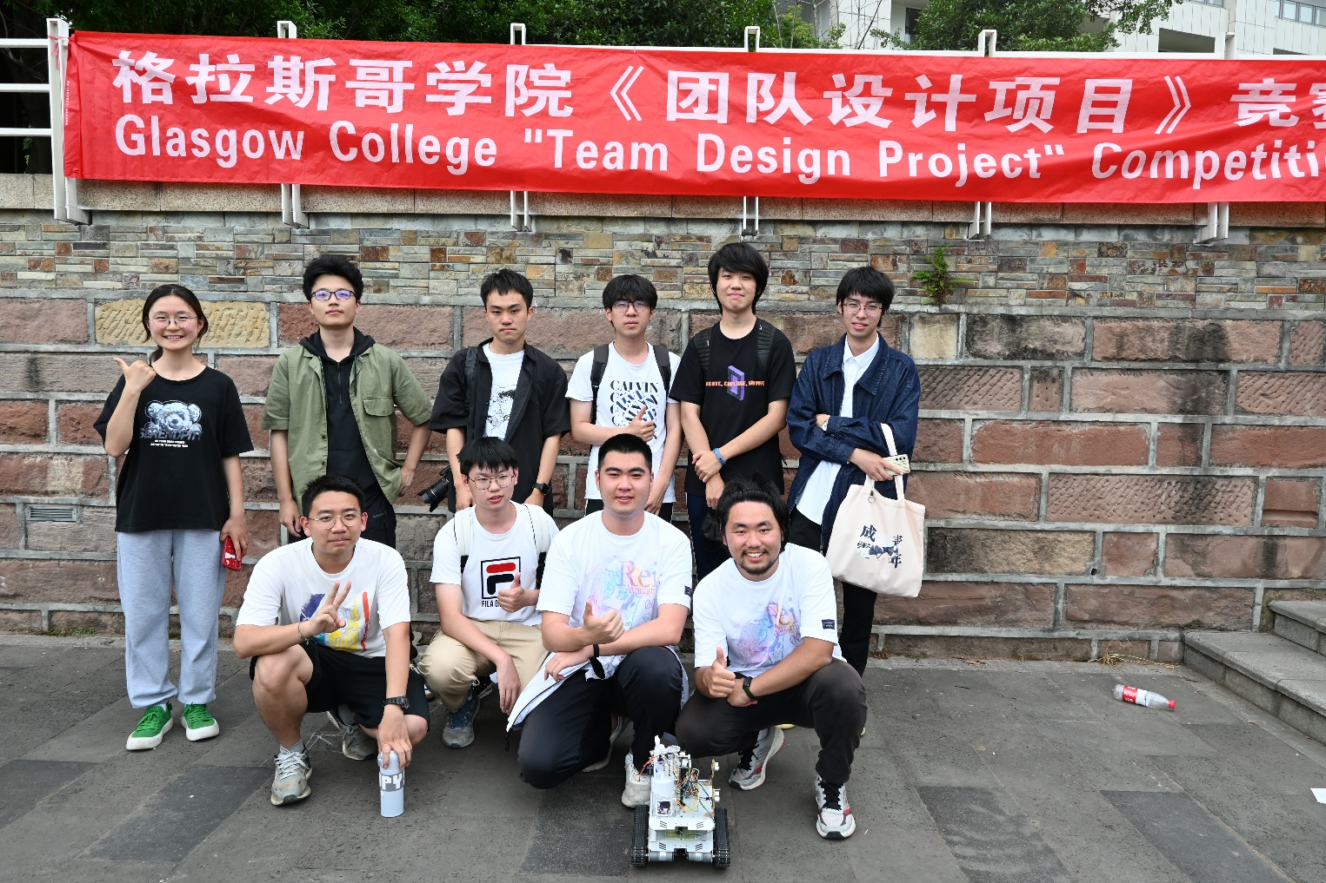
Thanks for your listening!

